Slide 1
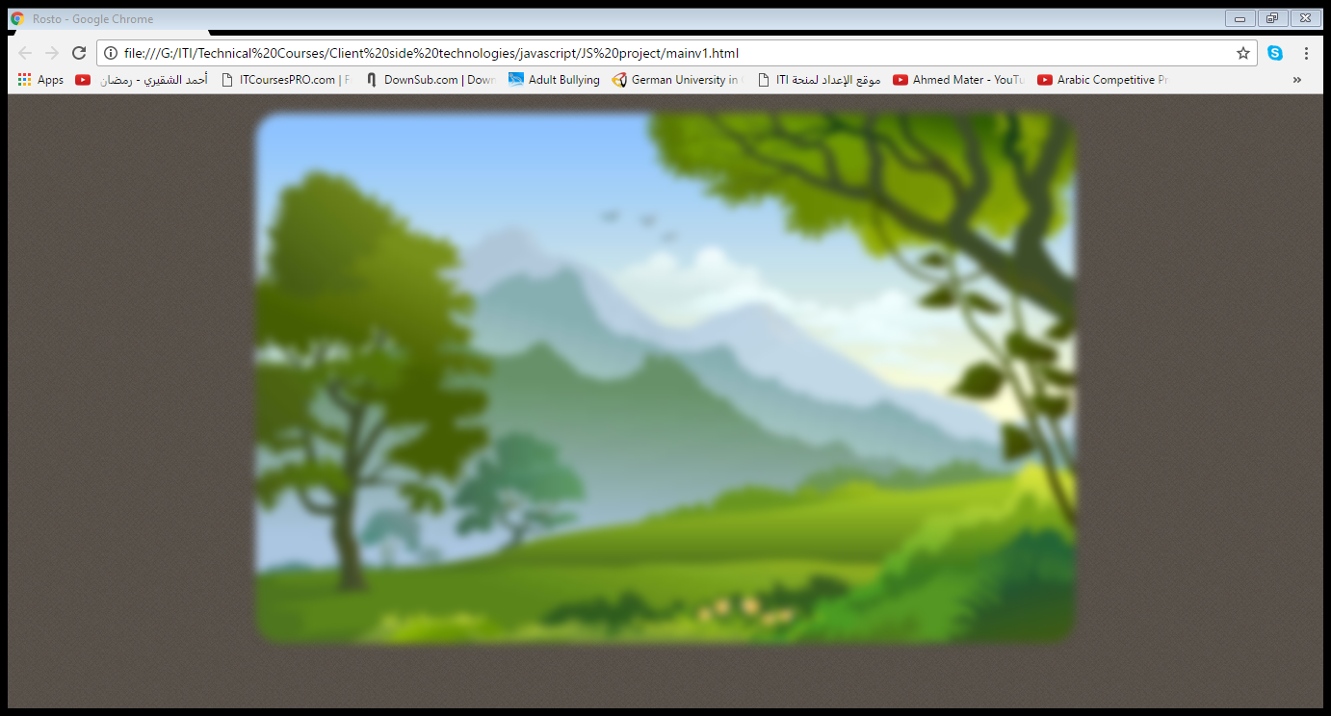





Slide 2



Slide 3
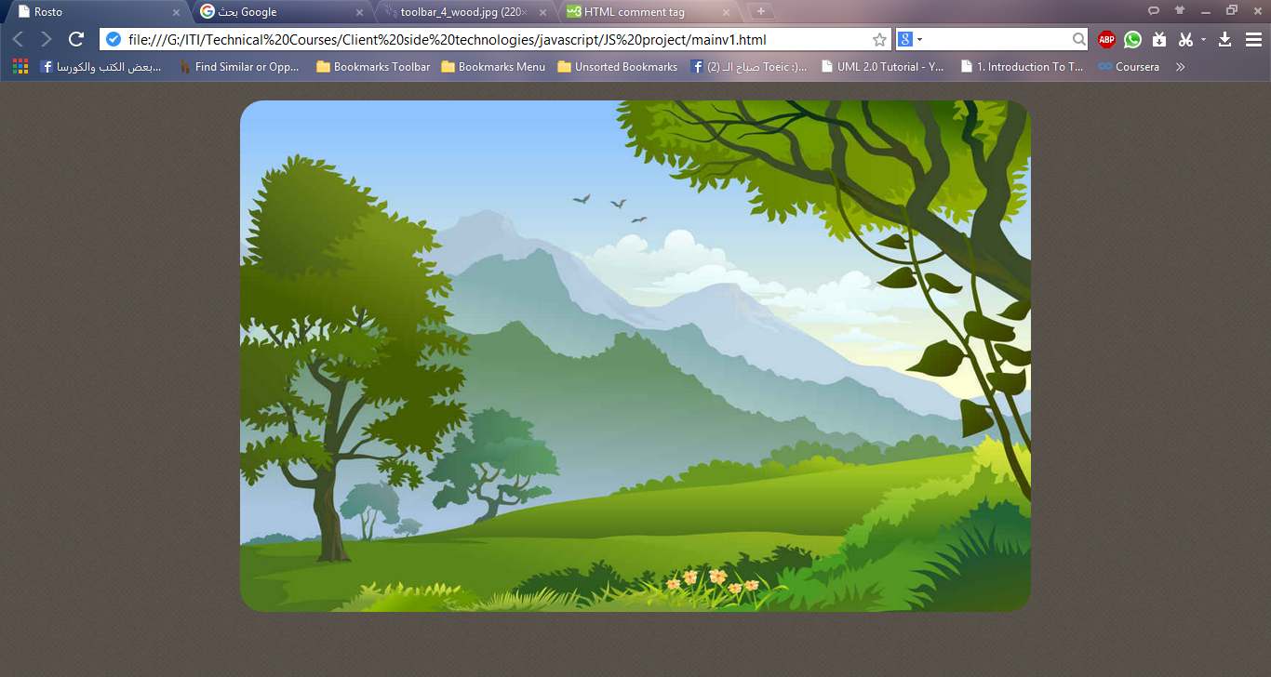

New Game
Instructions
About
Exit

Slide 4



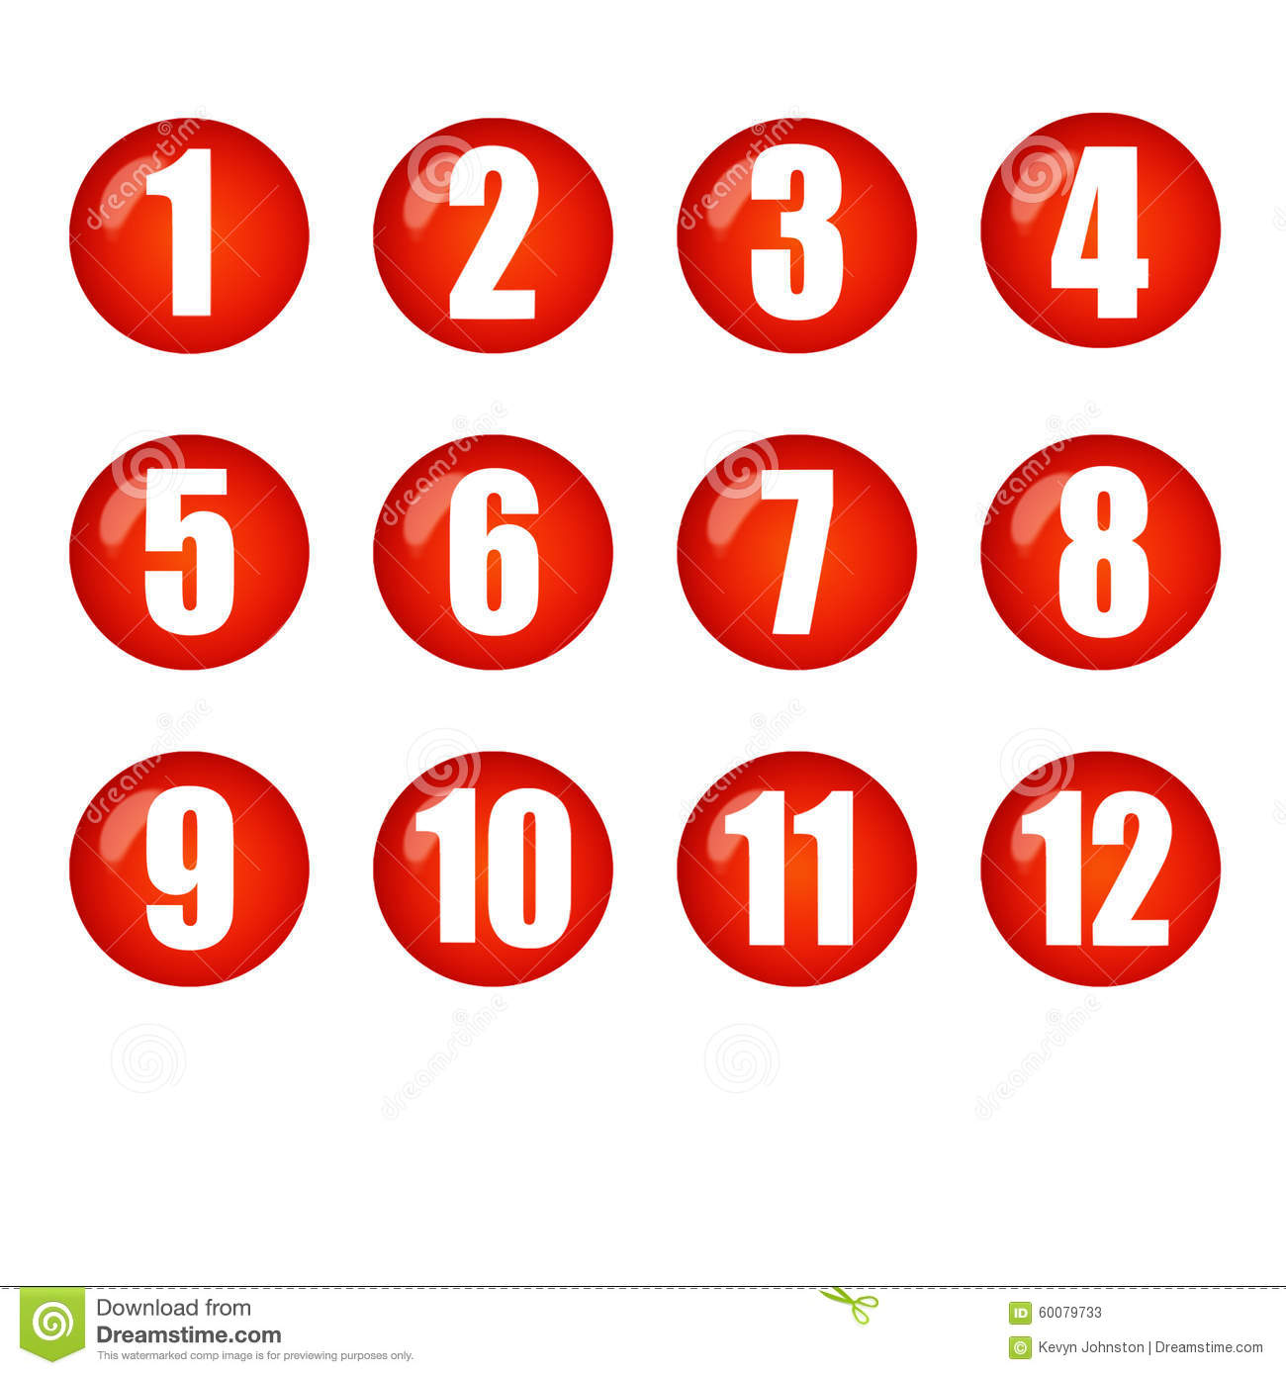



Slide 5









Slide 6



Slide 7



